Slide 1


CMR TECHNICAL CAMPUS
UGC(Autonomous)
Accredited by NBA & NAAC with ‘A’ Grade
Approved by AICTE , New Delhi & JNTU, Hyderabad.
Department of Computer Science Engineering
A Major Project on
Artificial Intelligence Crime: An Overview of Malicious Use and Abuse of AI
Presented by:
Ch. Niharika 217R1A0516
P. Nikitha 227R5A0502
A. Shivani 217R1A0501
Under the Guidance of
Mr. M. Madhusudhan (Assistant Professor)

Slide 2
TABLE OF CONTENTS
INTRODUCTION
ABSTRACT
EXISTING SYSTEM
DISADVANTAGES
PROPOSED SYSTEM
ADVANTAGES
SYSTEM REQUIREMENTS
NOVELTY
ARCHITECTURE
MODULES
UML DIAGRAMS
ALGORITHMS
SAMPLE CODE
RESULT
CONCLUSION
FUTURE SCOPE
REFERENCES
GITHUB LINK

Slide 3
INTRODUCTION
AI Crime
Importance of addressing vulnerabilities and potential misuse of AI
Objective of understanding how AI can be misused for malicious activities

Slide 4
ABSTRACT
Rapid evolution of AI and its integration into criminal activities
Four types of malicious abuse (e.g., integrity attacks, unintended outcomes, algorithmic trading, membership inference attacks)
Four types of malicious use (e.g., social engineering, misinformation, hacking, autonomous weapon systems)
Importance of collaboration to prevent harmful AI applications

Slide 5
EXISTING SYSTEM
Current Research on AI’s potential for malicious activities
Limitations: lack of terminology like "AI-Crime" to describe the re-orientation of AI technologies toward criminal activity
A typology is greatly useful in structuring research efforts and identifying gaps in knowledge in areas where more research is warranted.

Slide 6
EXISTING SYSTEM DISADVANTAGES
An existing methodology not proposed the term ``AI-Crime'' to describe the situation in which AI technologies are re-oriented to facilitate criminal activity.
An existing system doesn't implement for MALICIOUS ABUSE OF AI and VULNERABILITIES OF AI MODELS.
Need for a robust framework to handle integrity attacks

Slide 7
PROPOSED SYSTEM
Add to the emerging body of knowledge that maps types of malicious use and abuse of AI systems. To understand the main concepts, threat scenarios, and possibilities is necessary to develop much-needed preventive measures and proactive responses to such attacks.
Help in establishing a shared language among and across different disciplines, especially between STEM disciplines and legal practitioners, as well as policymakers. Interdisciplinary research on the topic can reduce confusion caused by excessively technical or monodisciplinary language and aid in bridging existing gaps.
Propose mitigation strategies, as well as demonstrating that a collective effort among government, academia, and industry is needed

Slide 8
PROPOSED SYSTEM ADVANTAGES
The system aims to propose a typology of the malicious use and abuse of AI based on empirical evidence and contemporary discourse, analyzing how AI systems are used to compromise confidentiality, integrity, and data availability.
Objectives are limited to identifying essential elements of the malicious use and abuse of AI, and to collect evidence of their use in practice. The compiled data enable further analysis of the possible ways in which AI systems can be exploited for criminal activities.

Slide 9
HARDWARE & SOFTWARE REQUIREMENTS
HARDWARE REQUIRMENTS
Processor - I5 CORE
RAM - 8 GB
Hard Disk - 1 TB

Slide 10
SOFTWARE REQUIRMENTS
Operating system : Windows 11
Coding Language : Python 3.7.0
Back-End : Django
Designing : Html, css, Javascript.
Data Base : MySQL (WAMP Server).

Slide 11
NOVELTY
Introduction of a New Typology: Novel classification of AI crimes, categorizing malicious use and abuse for better understanding and mitigation
1
Interdisciplinary Focus: Promotes collaboration between AI experts, legal professionals, and policymakers to bridge knowledge gaps
2
Proactive Mitigation: Proposes innovative, evidence-based strategies to prevent emerging AI threats like deepfakes and integrity attacks
3

Slide 12
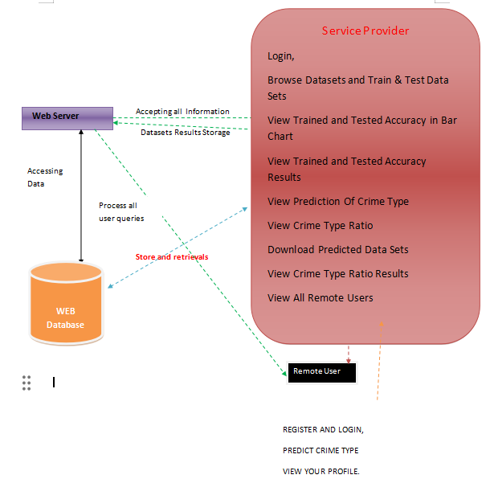
ARCHITECTURE

Slide 13
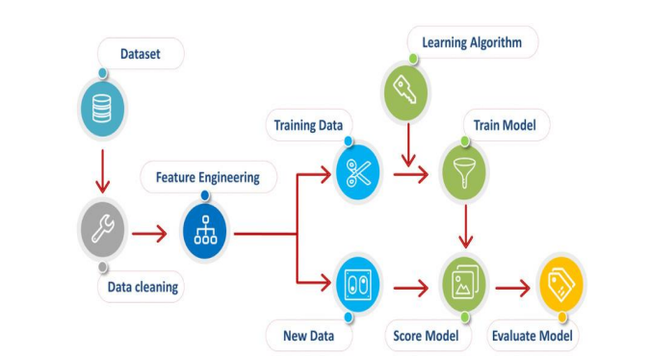

Slide 14
MODULES​
Remote User Module: Users register, log in, and interact with the system to predict crime types and view personal profiles
Service Provider Module: Manages dataset training/testing, views crime predictions, and analyzes accuracy results through bar charts .
User Authorization Module: Admin reviews and authorizes registered users by verifying their details before granting access .

Slide 15
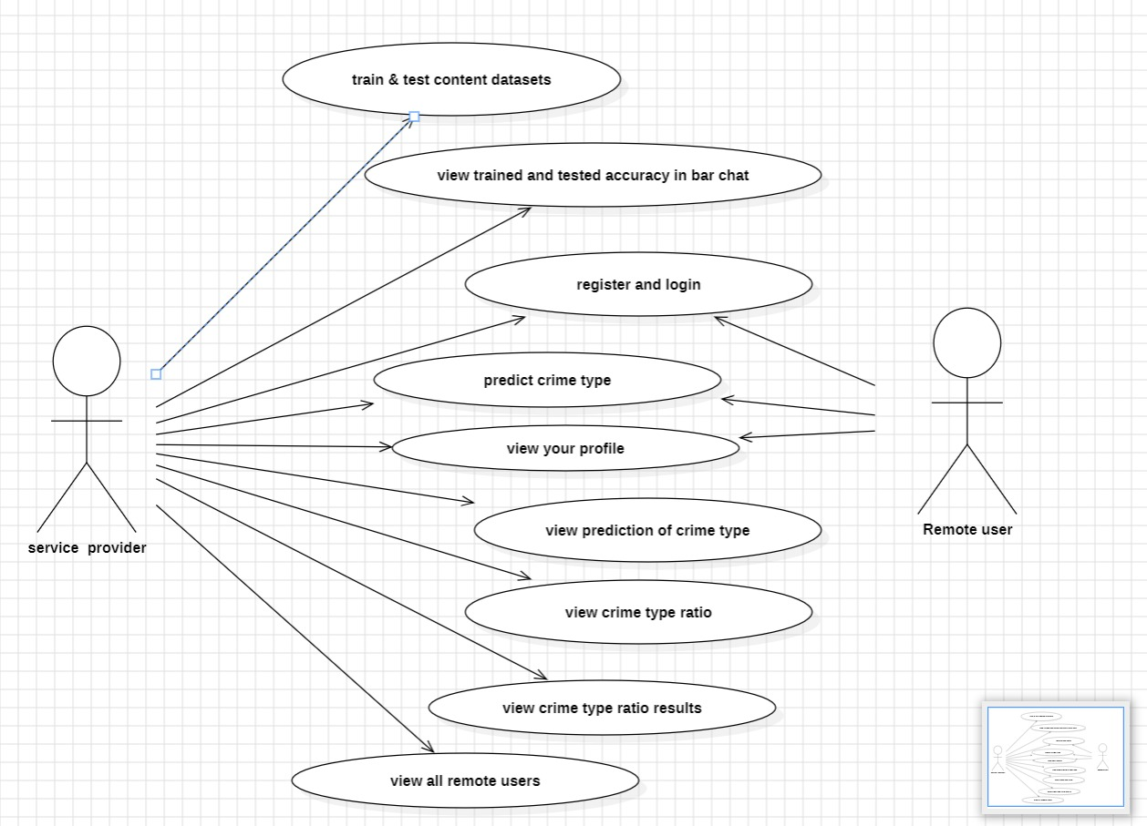
UML DIAGRAMS
USE CASE DIAGRAM

Slide 16
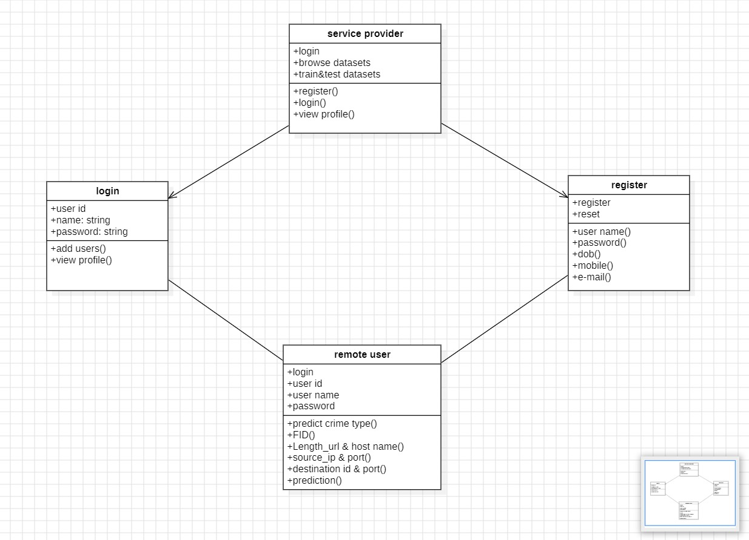
CLASS DIAGRAM

Slide 17
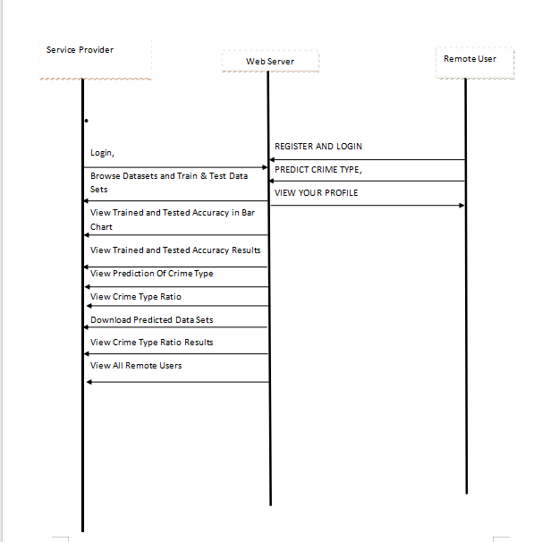
SEQUENCE DIAGRAM

Slide 18
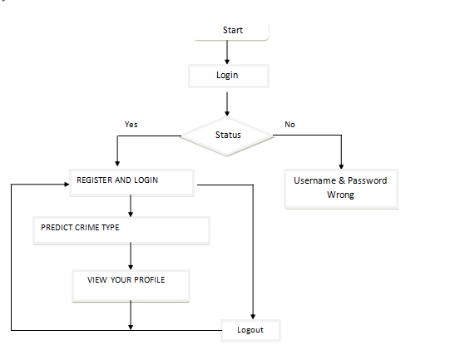
ACTIVITY DIAGRAM
Remote User

Slide 19
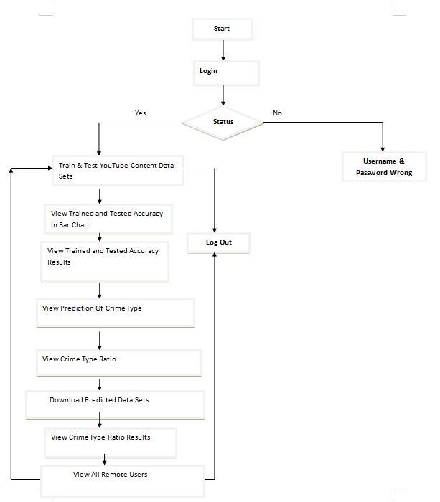
Service Provider

Slide 20
ALGORITHMS
Decision Tree Classifier: Extracts decision-making rules from data for crime prediction .
Gradient Boosting: Enhances accuracy by combining multiple weak models, often outperforming random forests .
K-Nearest Neighbors (KNN): Classifies crimes based on similarity to known cases, useful for pattern recognition .
Logistic Regression: Used for binary and multi-class classification, predicting the likelihood of crime types .
Naïve Bayes: A fast, probabilistic model used for crime classification based on prior knowledge .
Random Forest: Constructs multiple decision trees to improve accuracy and reduce overfitting .
Support Vector Machine (SVM): Separates crime data into categories using optimized decision boundaries .

Slide 21
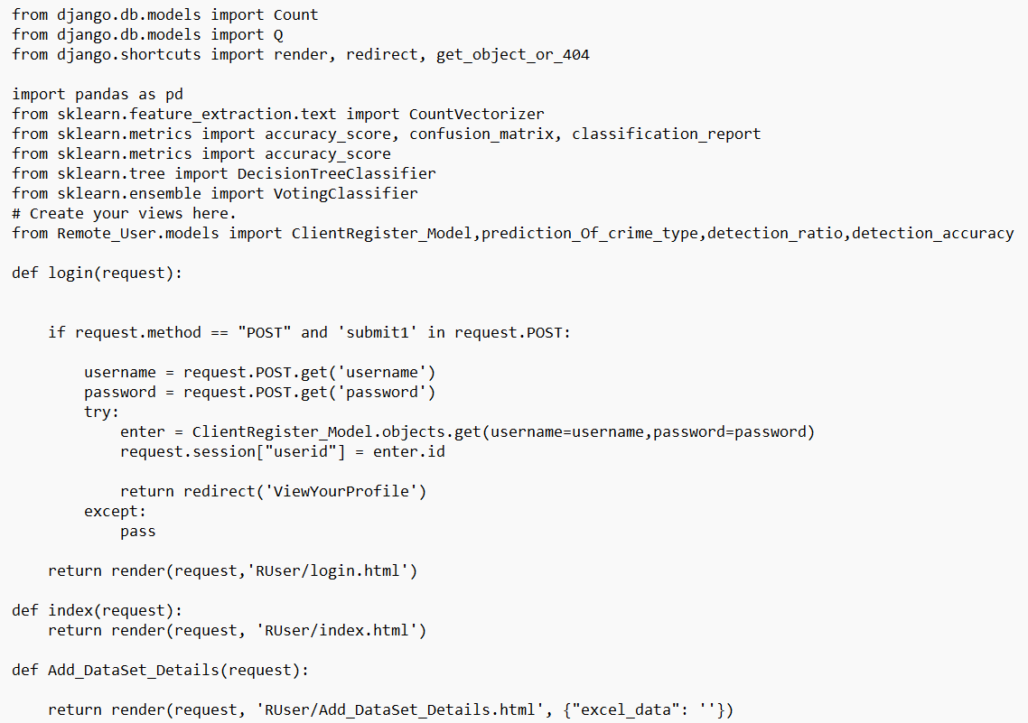
SAMPLE CODE –REMOTE USER

Slide 22
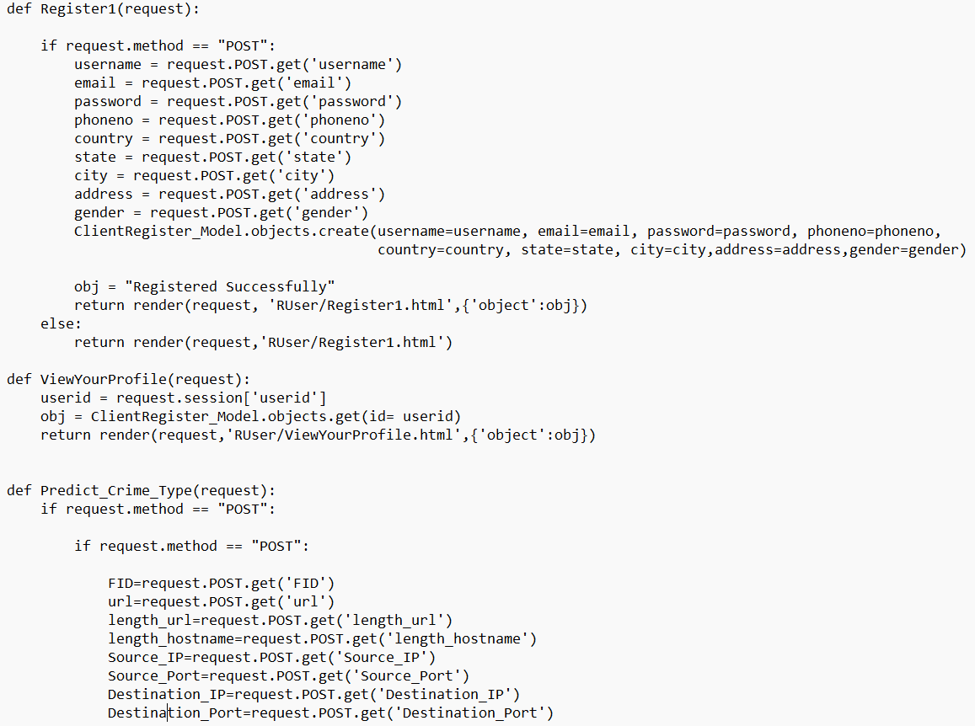

Slide 23
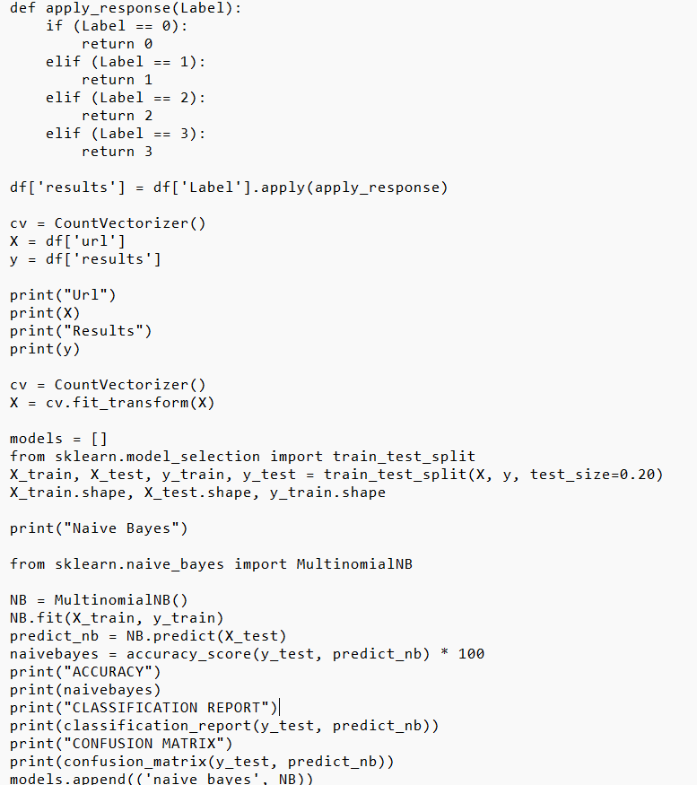

Slide 24
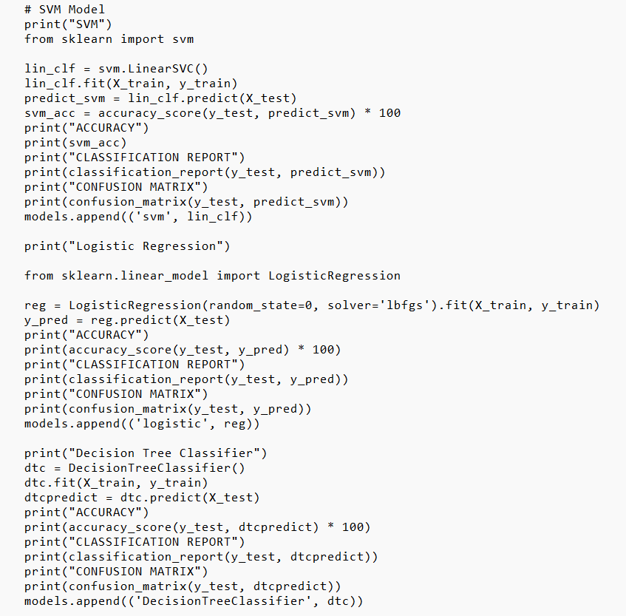

Slide 25
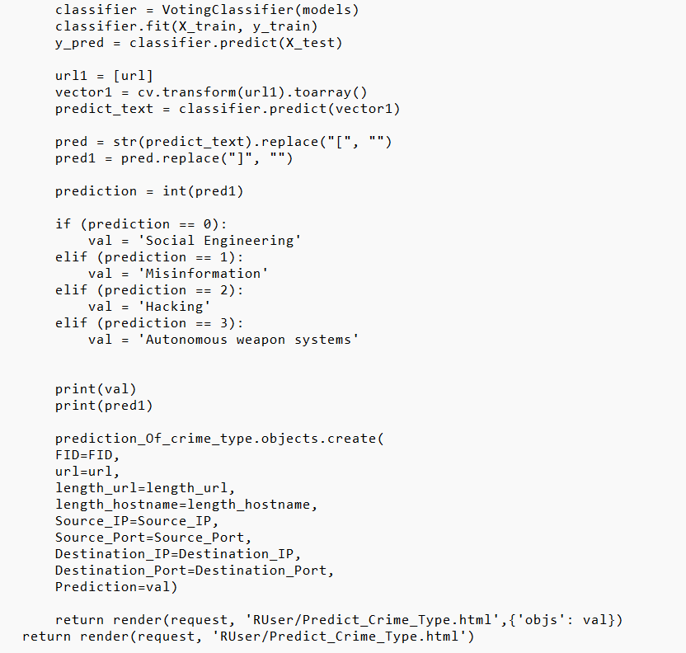

Slide 26
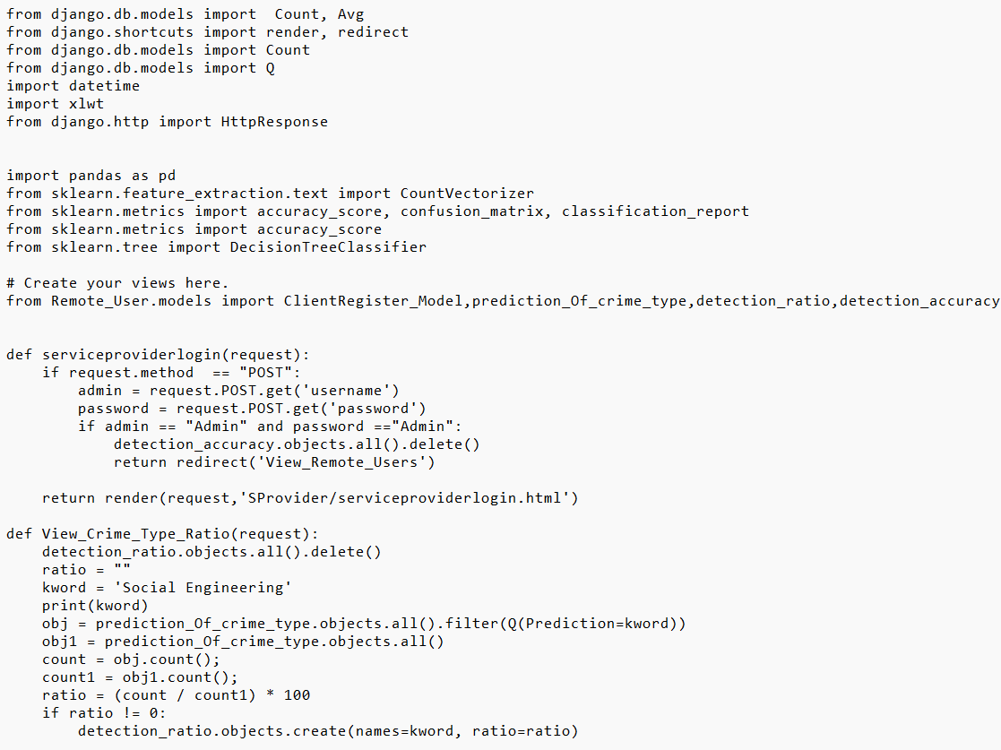
SAMPLE CODE – SERVICE PROVIDER

Slide 27
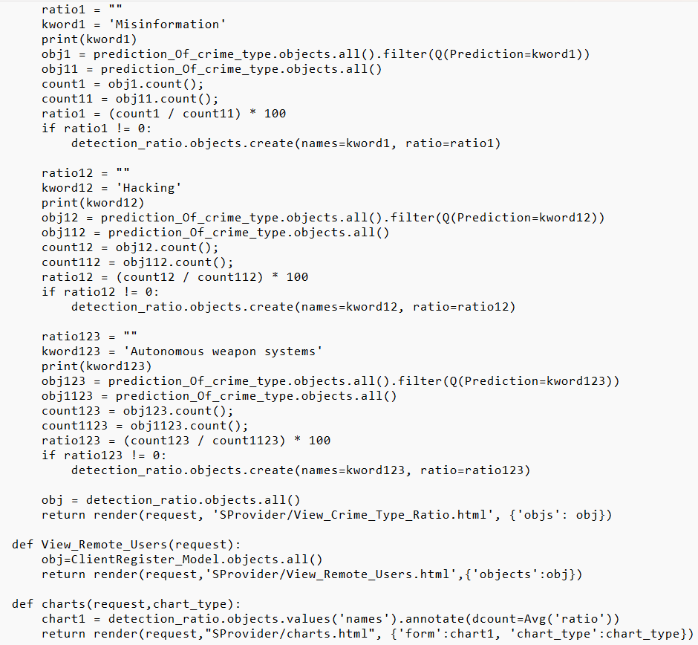

Slide 28
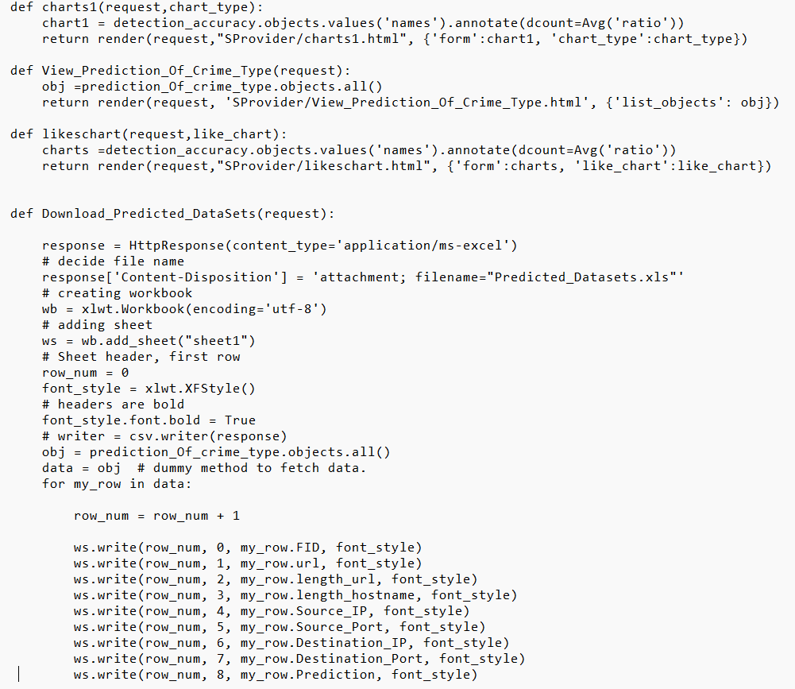

Slide 29
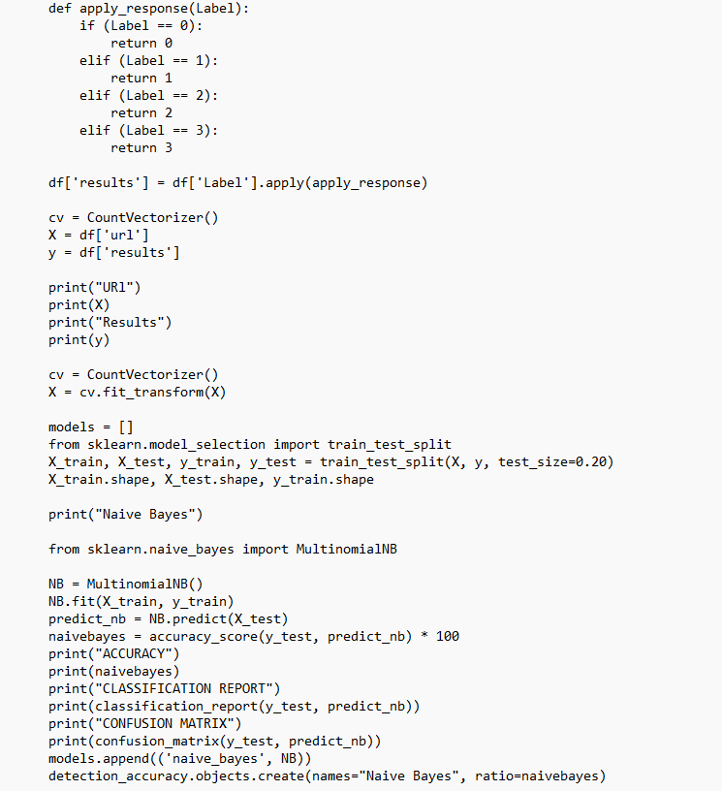

Slide 30
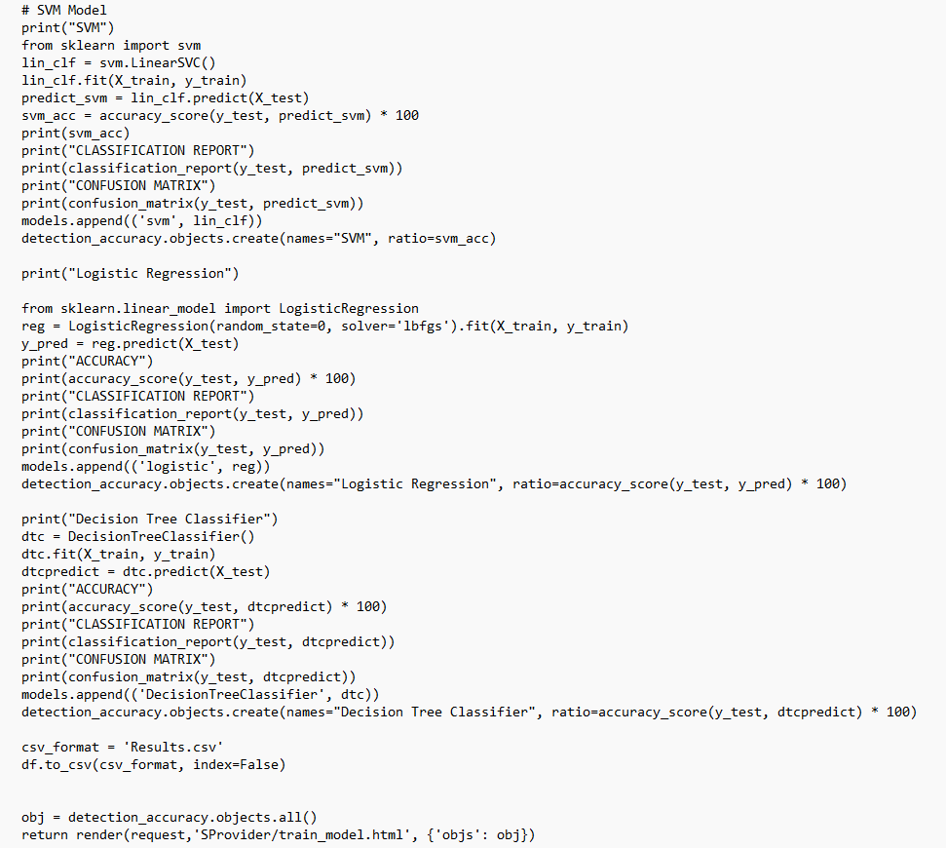

Slide 31
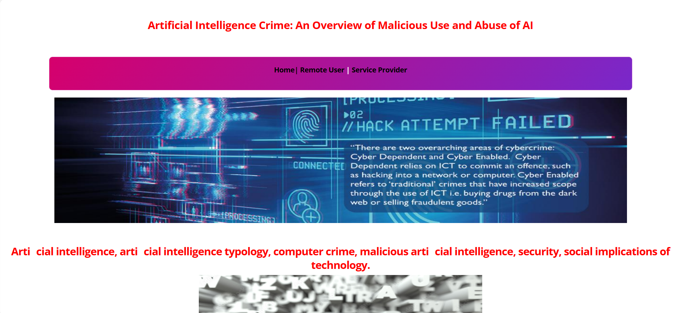
This is page where we have remote user and the service provider

Slide 32
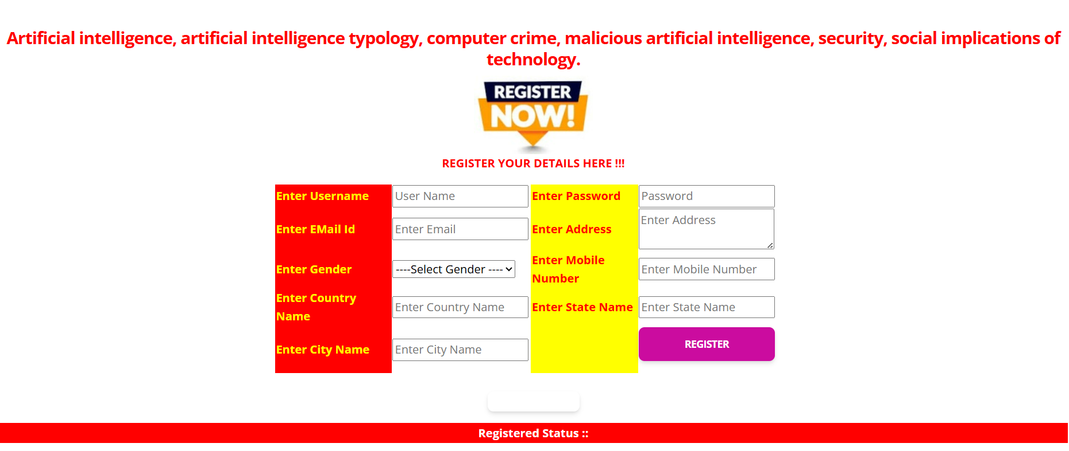
Register your details here for login into remote user

Slide 33
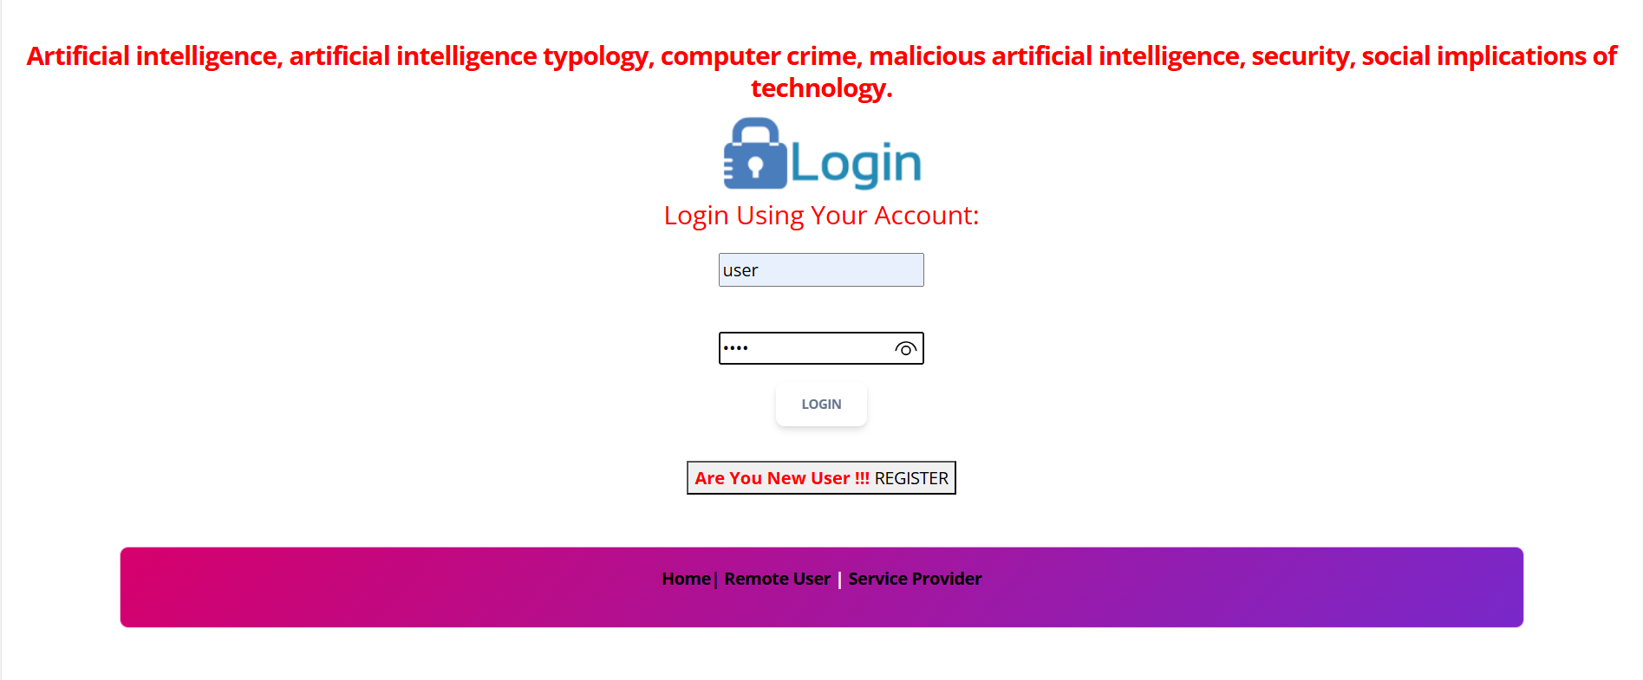
Login using your register details

Slide 34
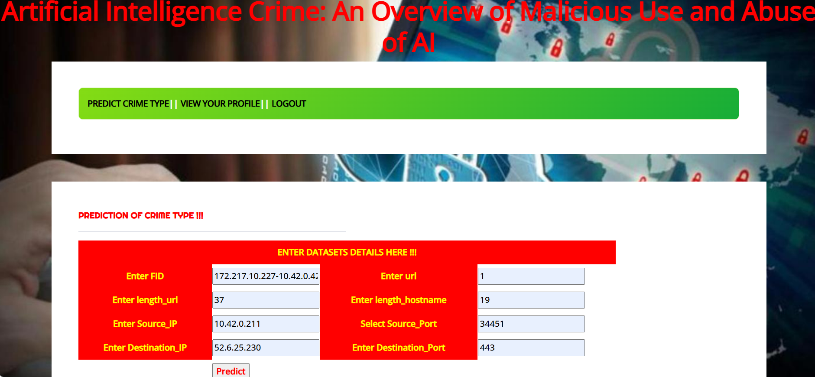
Enter the dataset details here and click on predict

Slide 35
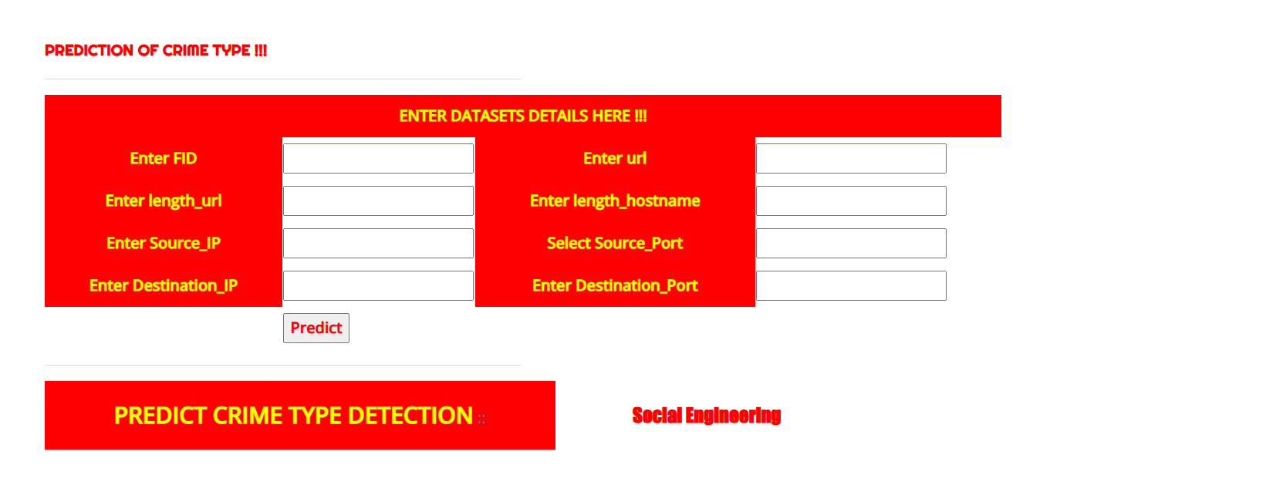
The dataset predict crime type detection as Social Engineering

Slide 36
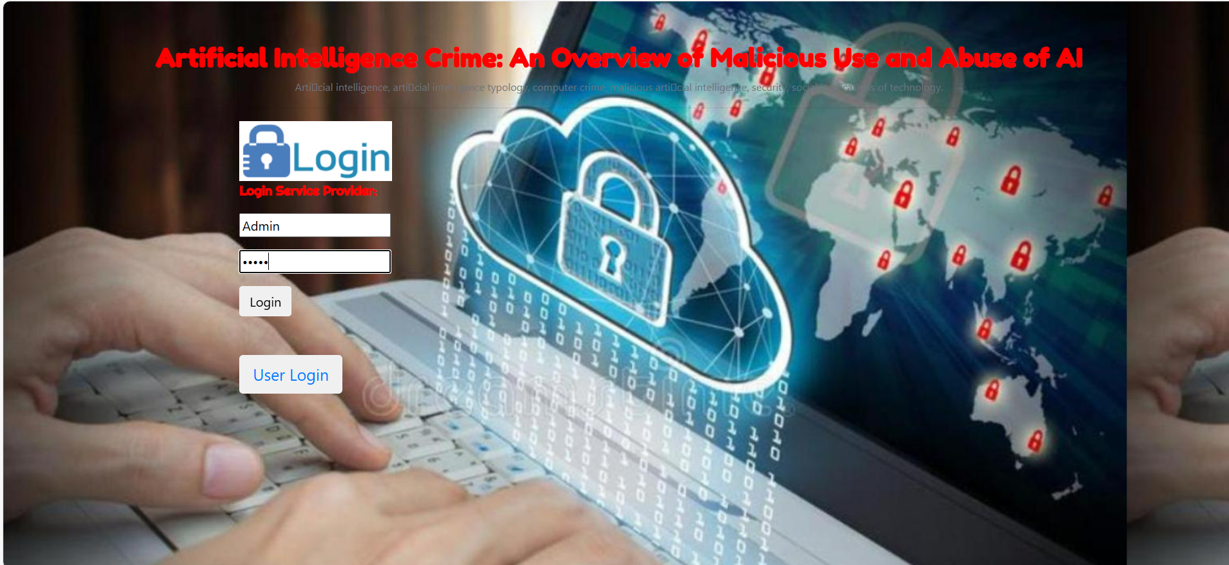
Login to the Service provider page

Slide 37
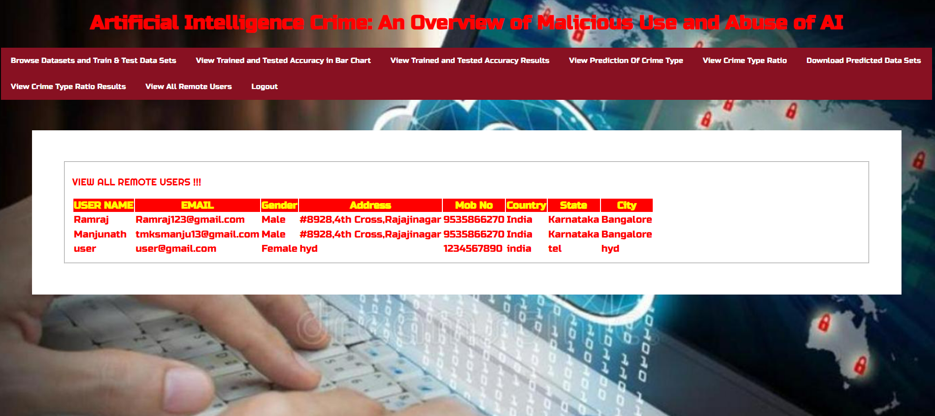
View all the remote user details

Slide 38
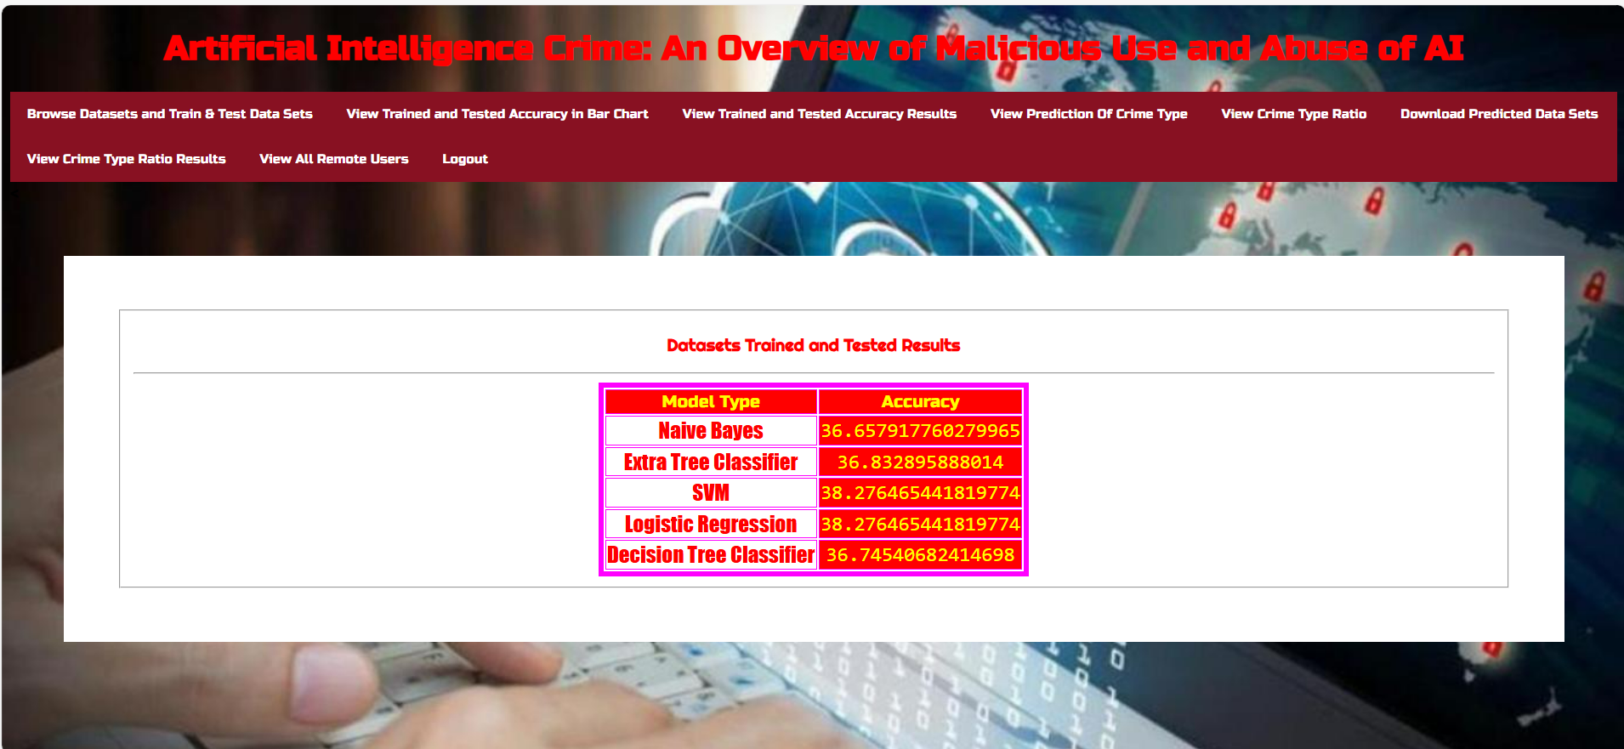
Accuracy of different algorithms where datasets are trained

Slide 39
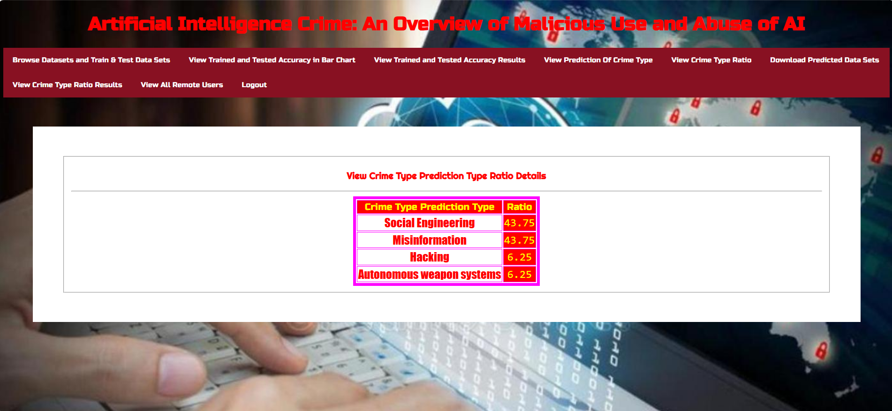
View crime type prediction type ratio details

Slide 40
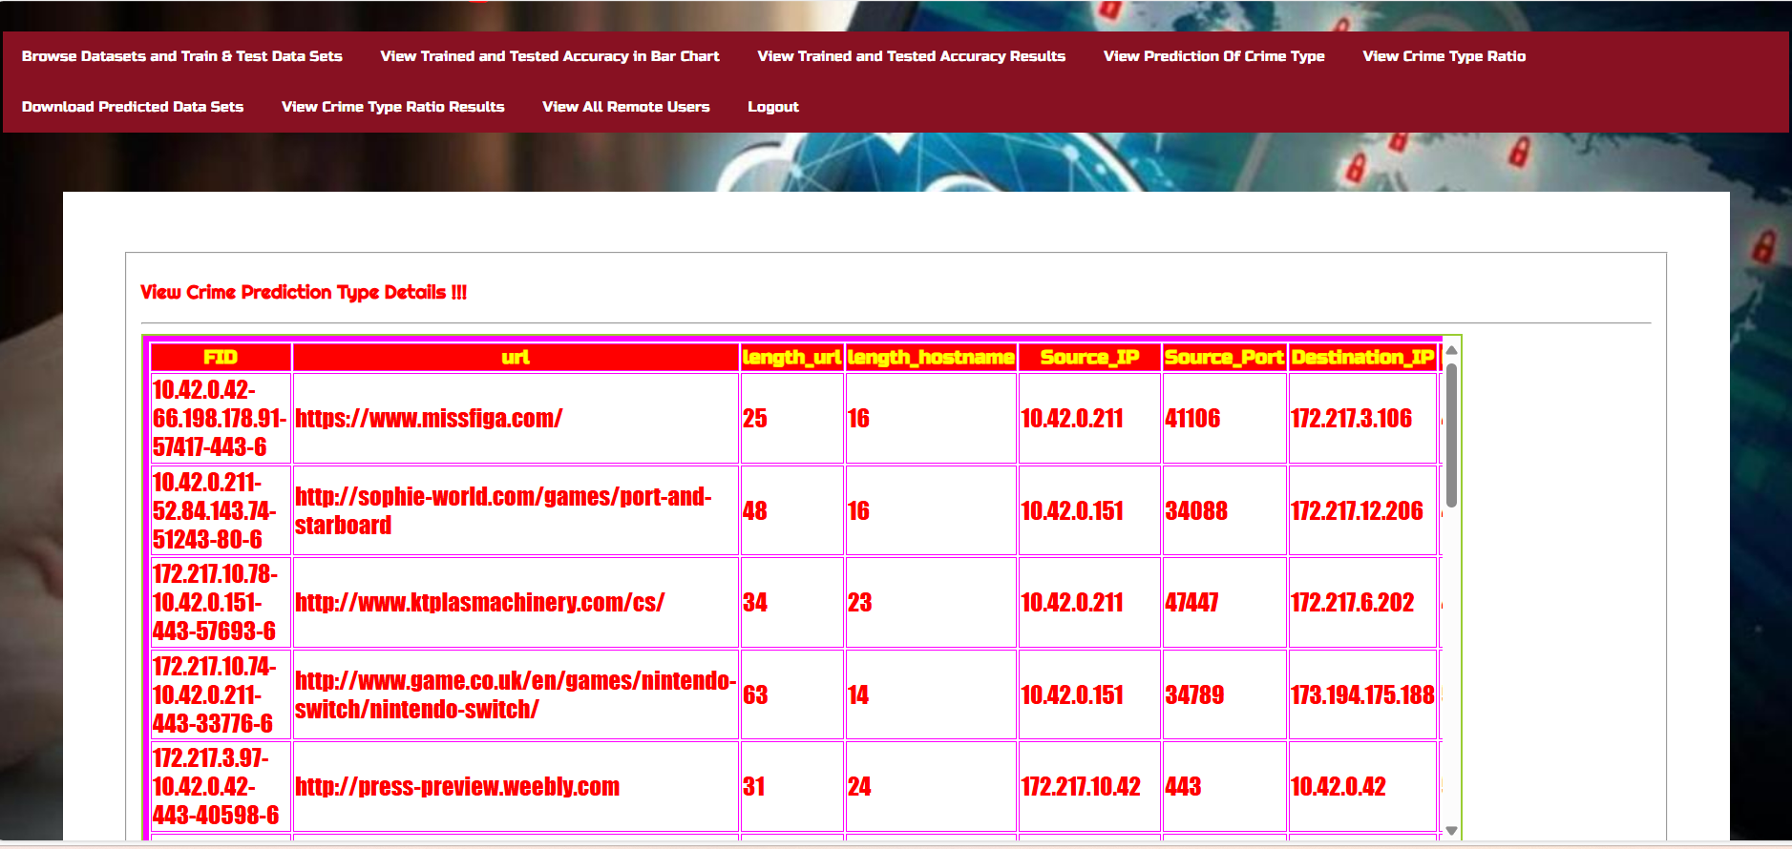

Slide 41
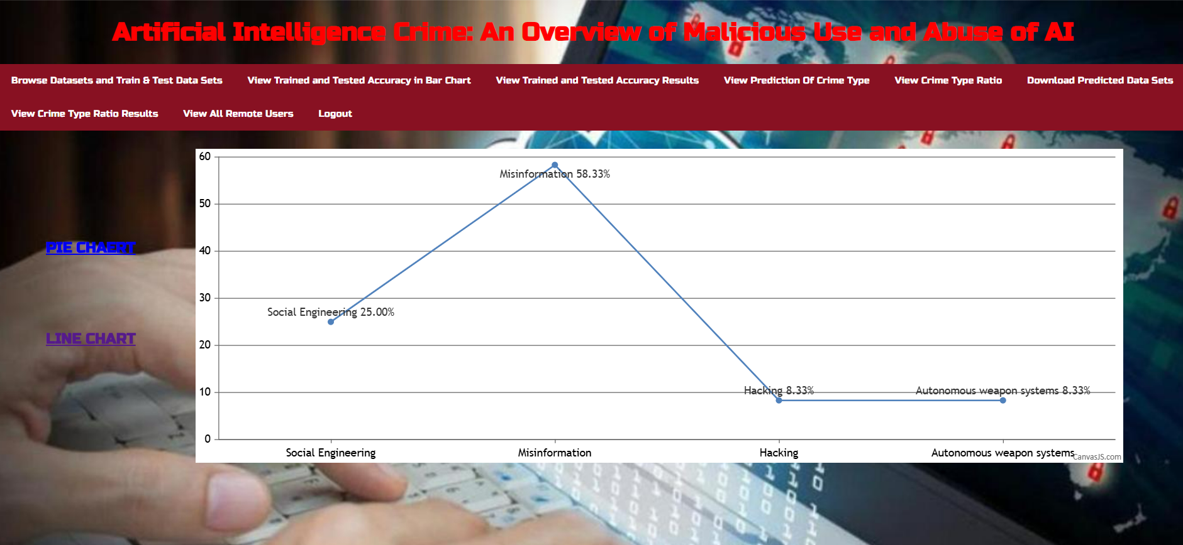
View trained and tested accuracy results

Slide 42
RESULT
Successful Crime Prediction: The system effectively predicts crime types based on trained AI models, improving detection accuracy .
User & Data Management: Enables seamless registration, authentication, and data access for authorized users, ensuring secure interactions .
Graphical Analysis: Displays crime prediction accuracy and crime type distribution through visual representations like bar charts .

Slide 43
CONCLUSION
AI Crime Classification: The project categorizes malicious AI use, including physical, psychological, political, and economic threats .
Identified AI Vulnerabilities: Explored risks such as unintended AI outcomes and AI-enabled attacks like deepfakes and forgery .
Case Studies & Real-World Incidents: Analyzed past cases like the 2010 flash crash and the Cambridge Analytica scandal to highlight AI misuse .
Need for Collaborative Efforts: Encourages cooperation between governments, industries, and individuals to improve AI security frameworks .
Scope for Future Research: Further empirical studies and statistical analysis can refine AI crime classifications and enhance preventive measures

Slide 44
FUTURE SCOPE
Enhanced AI Detection: Implement advanced AI models for more accurate crime prediction and real-time monitoring of malicious activities .
Integration with Law Enforcement: Collaborate with law enforcement agencies to use AI-driven insights for crime prevention and investigation .
Global Expansion & Legal Frameworks: Extend the system for international crime analysis and integrate evolving legal and ethical AI regulations .

Slide 45
REFERENCES
K. Crawford, Atlas of AI: Power, Politics, and the Planetary Costs of Arti cial Intelligence. London, U.K.: Yale Univ. Press, 2021.
D. Garcia, Lethal arti cial intelligence and change: The future of inter national peace and security, Int. Stud. Rev., vol. 20, no. 2, pp. 334341, Jun. 2018, doi: 10.1093/isr/viy029.
T. Yigitcanlar, K. Desouza, L. Butler, and F. Roozkhosh, Contributions and risks of arti cial intelligence (AI) in building smarter cities: Insights from a systematic review of the literature, Energies, vol. 13, no. 6, p. 1473, Mar. 2020, doi: 10.3390/en13061473.
I. vanEngelshoven. (Oct. 18, 2019). Speech by Minister Van Engelshoven on Arti cial Intelligence at UNESCO, on October the 18th in Paris. Government of The Netherlands.Accessed:Apr.15,2021.[Online].
O.OsobaandW.WelserIV,TheRisksofArti cialIntelligencetoSecurity and the Future of Work. Santa Monica, CA, USA: RAND Corporation, 2017, doi: 10.7249/PE237.

Slide 46
GITHUB LINK
https://github.com/NiharikaChillamcharla/Artificial-Intelligence-Crime-An-Overview-of-Malicious-Use-and-Abuse-of-AI

Slide 47


